Slide 1

Hobby project: Fantasy Database
Callum Robinson
22FebEnable3

Slide 2
Intro & Concept
One place to store all your ideas for characters and weapons so that they can be used in the future during campaigns or one-shots
Can be used by both players and DMs running sessions
The data can easily be read or updated when events happen during a session
Notes:
Intro of myself
One of the big issues in D&D can be getting your ideas down on numerous character sheets
As a D&D fan I liked the idea of somewhere you can store you Character and weapon ideas

Slide 3
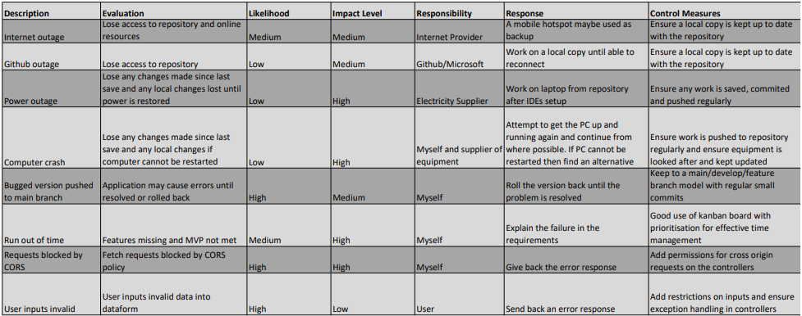
Risk Assessment

Slide 4
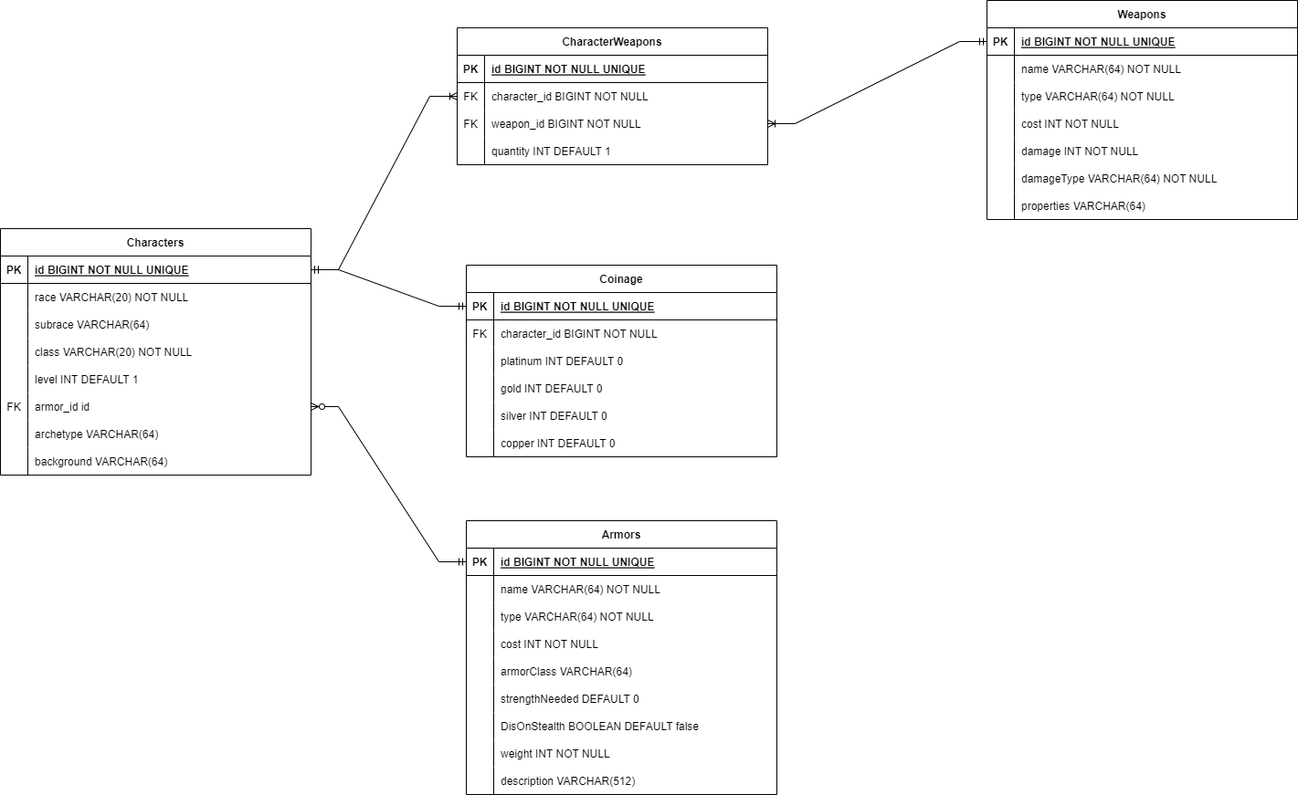
ERDs
Initial ERD concept
Out of scope for this project

Slide 5
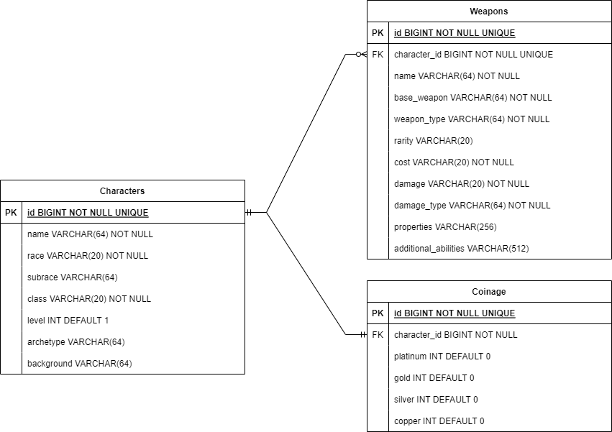
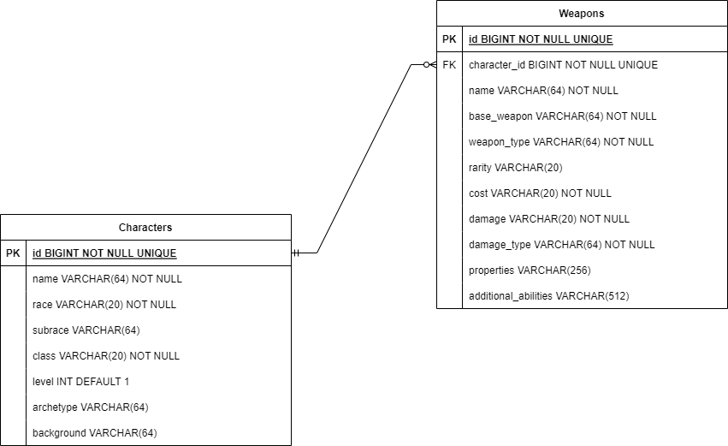
Planned ERD with 3 Entities
Final ERD with 2 Entities

Slide 6
Sprint planning
Let us go to the created Kanban Board:
https://callumjrobinson.atlassian.net/jira/software/projects/HP/boards/3

Slide 7
Journey
Version Control
Sprint Planning / Planning Boards
Database Management
Java
Spring
HTML
CSS
JavaScript
Maven
Junit and Mockito
Lombok (independent)
Notes:
Git and github
Kanban boards with Jira
MySQL and h2 Databases
Give a brief explanation on the journey through these and their use in this project

Slide 8
Version Control
Created two empty repositories on Github
Instead of cloning the back-end it made more sense to push a starter spring application
Then create new branches following a main/dev/feature type model
Stage, commit and push and changes
https://github.com/Callum-Robinson/hobby-project-backend/tree/develop

Slide 9

Testing
Unit Tests were created for both service classes
This include all CRUD functionality and their exceptions
Achieved 82% coverage across src/main/java only missing controllers
Lombok annotations were ignored by the coverage using the following:
A quick demonstration
Notes:
Demonstrate the Coverage and testing

Slide 10
Demonstration Time
The locally-hosted front end: http://127.0.0.1:5500/index.html
Lets try-out some of the user stories for the different CRUD functionalities

Slide 11
Sprint Review
What was completed
The MVP of the application concept
Full CRUD functionality for both entities
Styling added to front end with some links to additional resources a user could want
What was left behind
The third entity ‘Coinage’ and fourth entity ‘Armour’
Integration tests for the controllers
Use of a static analysis tool

Slide 12
Sprint Retrospective
What went well
Board and diagrams planned well
All wanted CRUD working as intended
Good progress and time management working through the back-end
What could be improved
Better planning to deal with bugs especially in the front end
Integration tests to be done
Added in the 3rd entity functionality

Slide 13
Conclusion
Very happy with current application using everything used so far in this course
Increased understanding of everything covered so far
Increased experience with debugging and finding errors
The application can be expanded upon with further functionality
More practice with the front-end is needed especially JavaScript and CSS

Slide 14
Questions?

